Slide 1
Arduino Project Tutorial
Catalin, Aidan, Simone, Cameron
CASC

Slide 2
Roles
Catalin - Project management / Video tutorial.
Aidan – Engineering/ budget
Cameron – Coder
Simone – Coder / Equipment manager

Slide 3
Our idea
We will play the song Sandstorm by Darude on a Arduino. It will consist of a computer program that will allow the user to output the song by a Passive Speaker Buzzer. The program uses notes that are already inputted into the system so the buzzer know when to make the out sound and make the melody of the song so that humans can hear it. This is all by using the Beep() function & Sleep() Function which it delays the sound so that can make the beep.

Slide 4
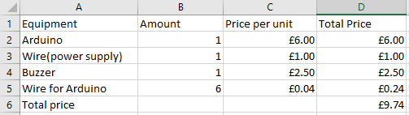
Resource list and budget

Slide 5
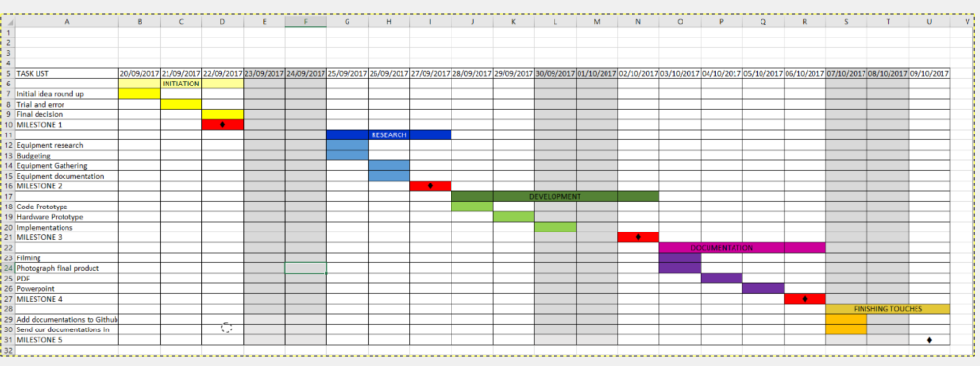
Gantt chart

Slide 6
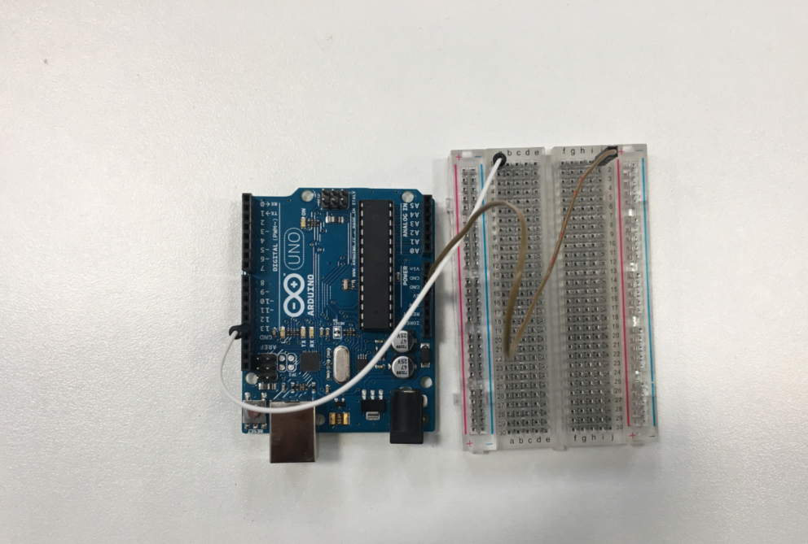
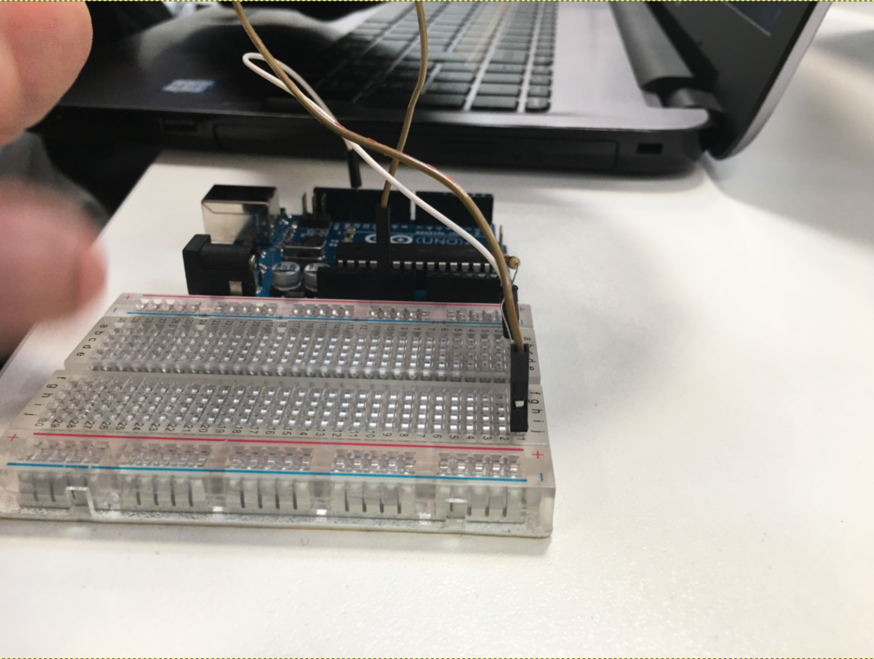
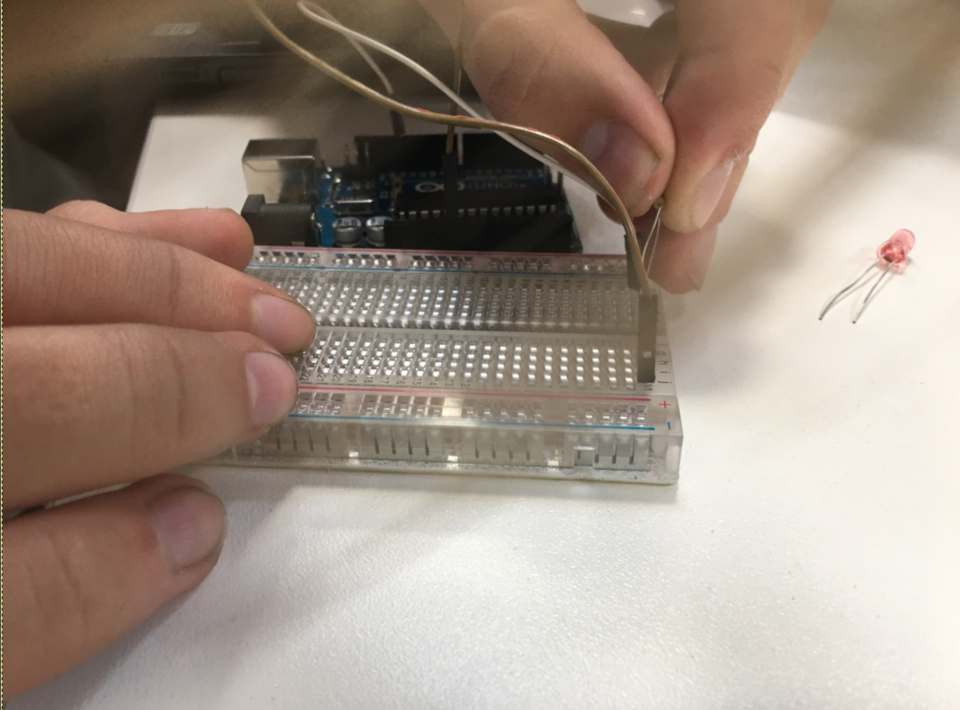
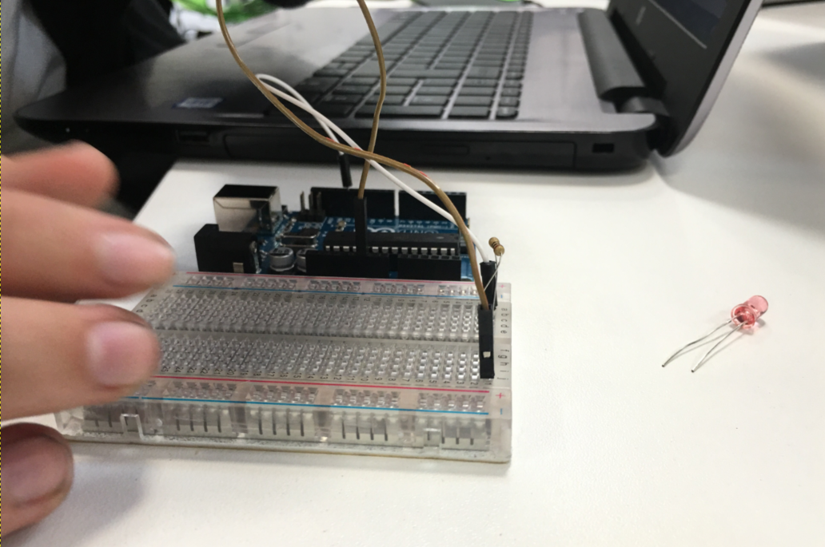
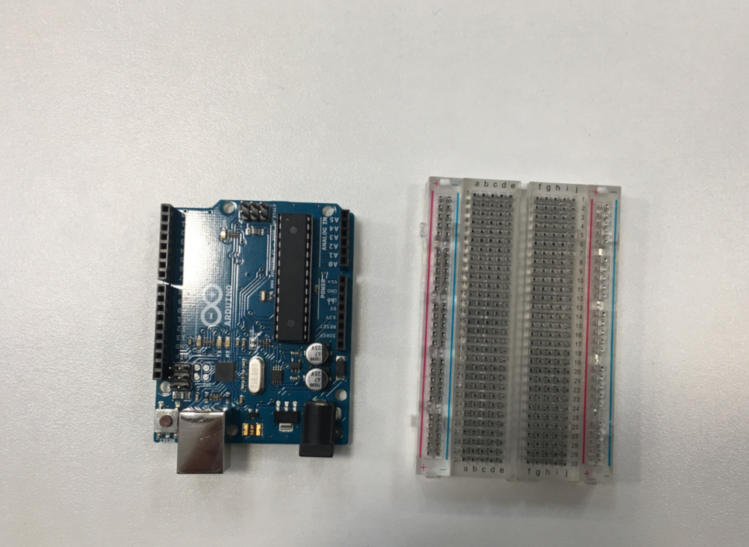
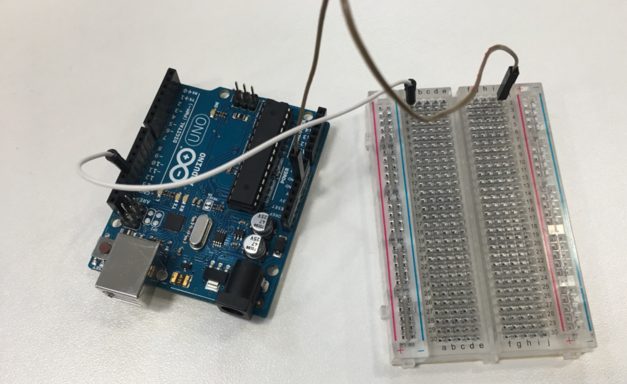
step-by-step images

Slide 7
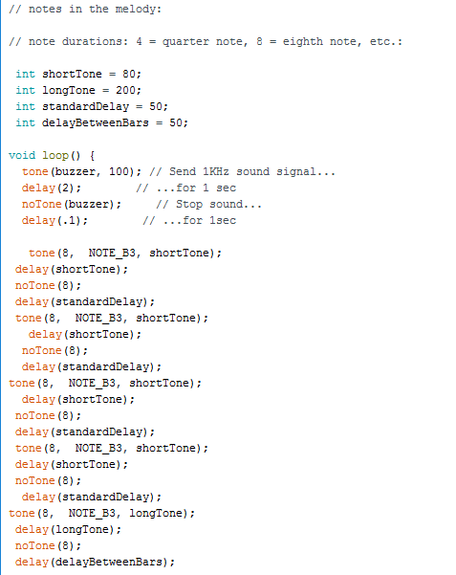
Code
The image shows the code that makes the buzzer to sleep or beep and the frequency that the buzzer would play the song. The code shows the pin were the buzzer would be placed and make the tone and makes the delay of the sound to make the melody.

Slide 8
Anything else add this
https://www.amazon.co.uk/wooden-box-Storage-Jewellery-Gadgets/dp/B01JO8NGPE/ref=sr_1_6?ie=UTF8&qid=1506518280&sr=8-6&keywords=small+wooden+box
https://www.youtube.com/watch?v=RUXjHIPx4zw&list=PLSZGgib9i9Nv94re5DETTfYvnx22mnwwp&index=3

